Slide 1
Brownfield to Greenfield: Solar on the Town Landfill
February 2018
Prepared by the Cumberland Climate Action Team
Eric Fitz, Denny Gallaudet, and Jane Wilson
Notes:
Jane intro

Slide 2
Overview
Introduction
Town Electricity Costs
Solar Background
Maine Example – South Portland Landfill Project
Estimated System Size, Costs, and Benefits
Next Steps

Slide 3
Cumberland Climate Action Team
Founded 2016 by Denny Gallaudet, Eric Fitz, Bob Waterhouse, and Jane Wilson
Combined 100+ years as town residents
Vision: Reduce Cumberland’s carbon footprint by 50% by 2020
Previously presented to the Town Council - August 2016

Slide 4
Challenge
The Town spends ~$120k per year
on electricity
Opportunity
Reduce costs and source majority of electricity from clean solar energy

Slide 5
Town Electricity Costs

Slide 6
Excluding street lighting, ~$70-80k per year is spent across nine town properties.
~$25k
$20k

Slide 7
There are 3 cost components: meter service, demand (kW) and energy (kWh) charges.
Meter Service Fee
Maine regulations allow the town to own and operate a solar system to reduce kWh costs
Demand Charge
(kW)
Energy, Transmission
& Distribution (kWh)
Opportunity to reduce costs
60%

Slide 8
Solar Background

Slide 9
Solar Photovoltaic (PV) = electrical energy

Slide 10
How does Solar PV work?
1
Solar panels convert sunlight into DC Power
4
Power flows out to the electric grid
2
DC
Inverter converts DC to AC Power
3
A meter records generated energy
AC

Slide 11
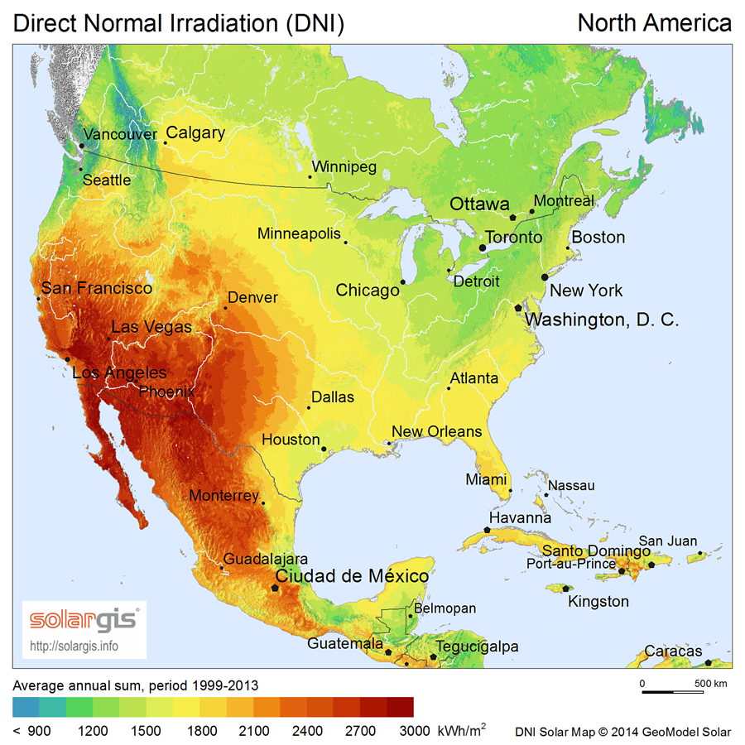
Cumberland has better solar potential than Houston!
US Solar Insolation (Sun Intensity)
Good sun
High local kWh price

Slide 12
Solar PV is one of the lowest cost options for new utility-scale generation in the US.
Source: Lazard’s Levelized Cost of Energy Analysis Nov 2017

Slide 13
What happens at night or in the winter?
Net Metering:
A system of utility managed credits and debits on electricity bills
DC
1 kWh
5 kWh
+ 1 kWh
AC
- 1 kWh
Notes:
Town is still fully connected to the grid and gets electricity from CMP

Slide 14
South Portland’s Solar Landfill Project

Slide 15
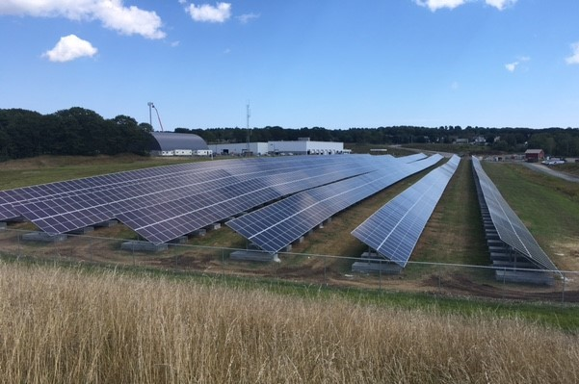
Solar PV, sited on closed municipal landfills, are common through out the US and Maine.
South Portland’s capped landfill
Summer 2017
Photo: Courtesy of South Portland

Slide 16
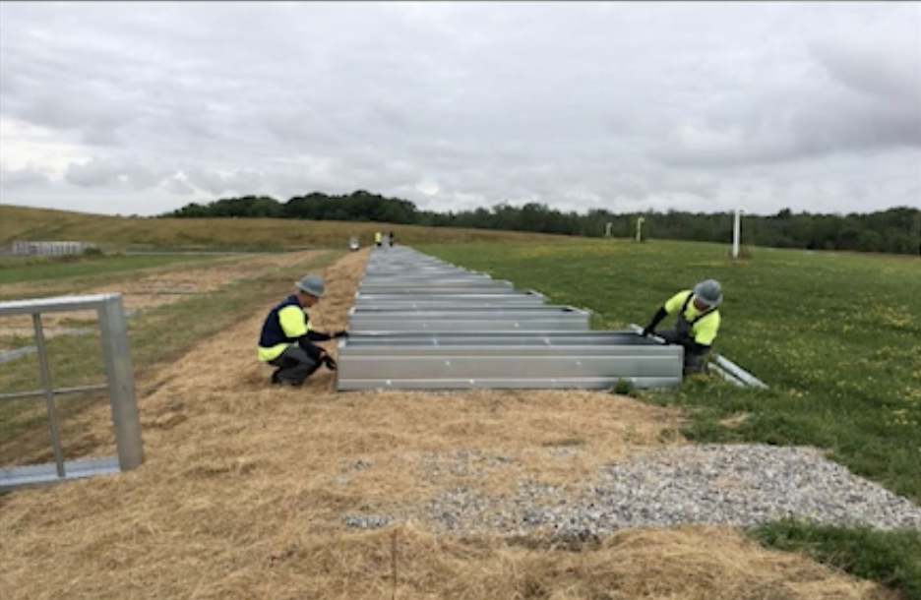
Solar array structure is ballasted to “float” on the surface of the capped landfill.
Concrete Ballasts
Photo: Courtesy of South Portland

Slide 17
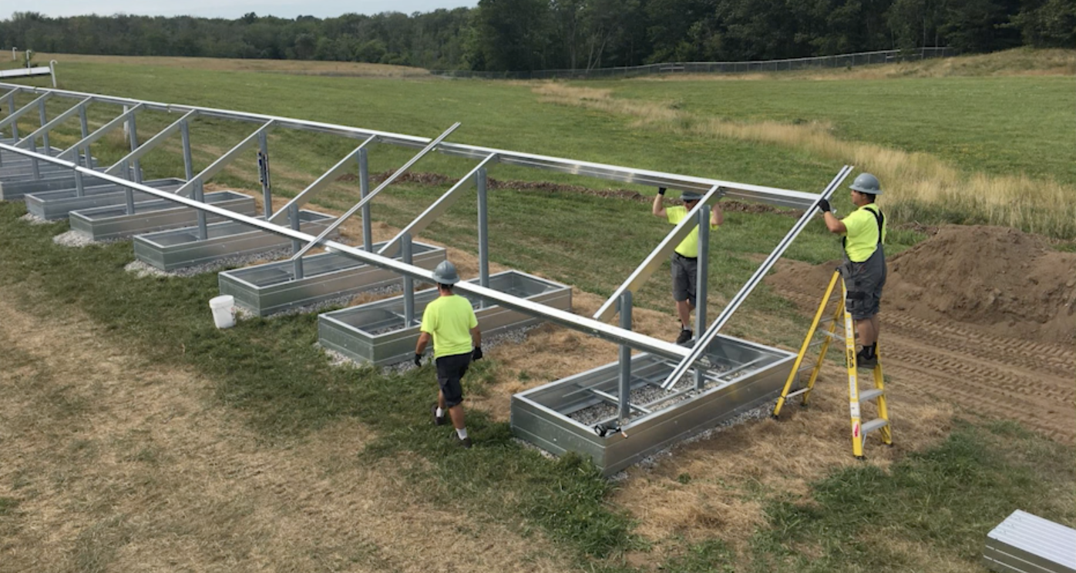
System is built with simple tools and process.
Solar Panel Racks
Concrete Ballasts
Photo: Courtesy of South Portland

Slide 18
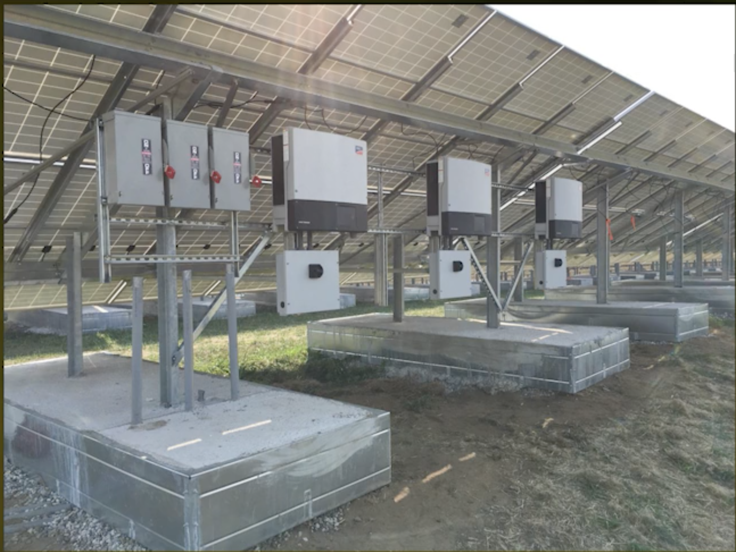
Mount panels and connect to inverters
Mounted Panels
Inverter
Photo: Courtesy of South Portland

Slide 19
Estimated System Size, Costs, and Benefits: Cumberland Solar Landfill

Slide 20
A solar array on Cumberland’s landfill could cover nearly 100% of the town’s usage.
Usage
Solar Output
Net Metering
Works 24/7 and from season to season.
A well sized system ensures all credits are consumed in a 12 month period.

Slide 21
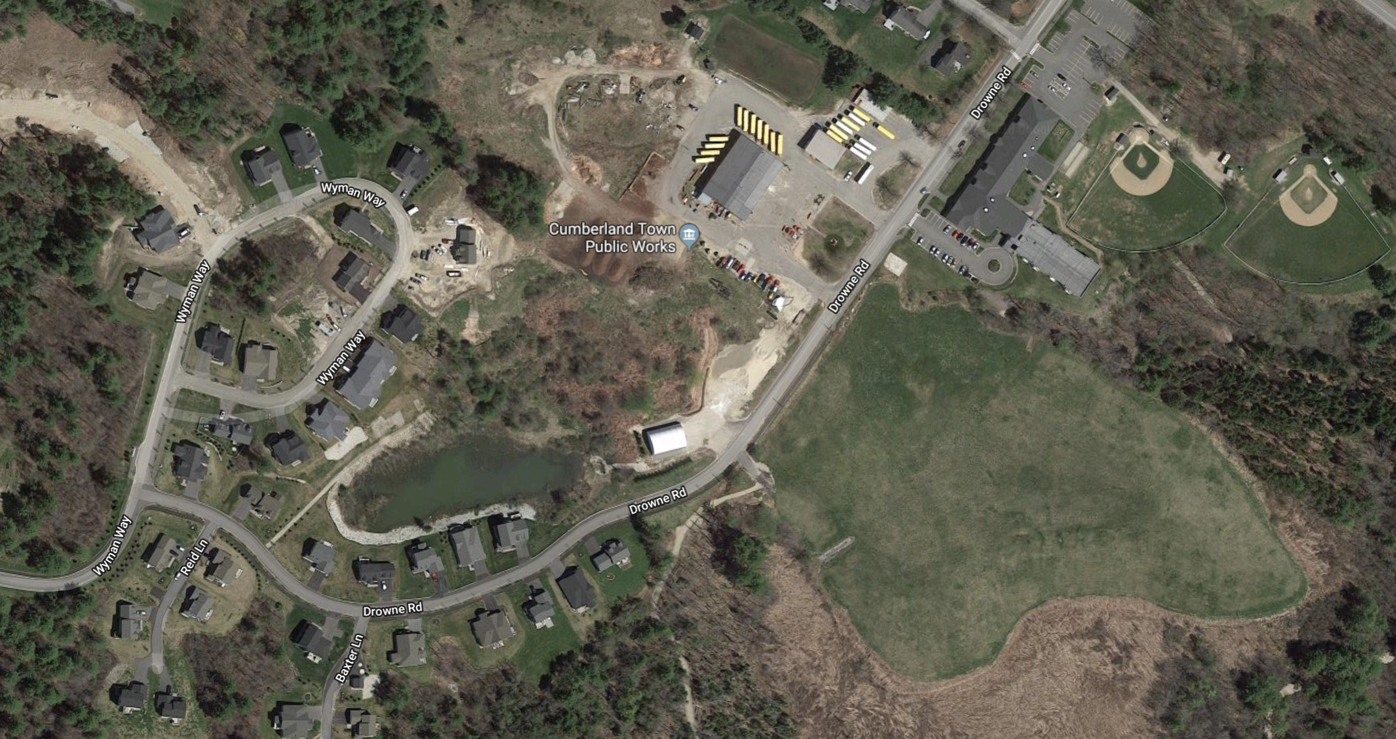
Town Public Works
Landfill
Ideal site
Approximate scale/location
Steep terrain

Slide 22
There are two common ways of financing a project like this.
Financing
Option A: Town only
Option B: Town + PPA*
South Portland
Town will save up to $2.4M over the life of the system.
$1-1.2M
$0.6-0.8M
1
3
Investor owns
& operates system
Town buys system at
30 - 45% discount
Federal Tax Credit
Accelerated Depreciation
Free electricity
2
Town purchases electricity from investor via PPA
1 40 years
7 years
*PPA = Power Purchase Agreement

Slide 23
Summary: Brownfield to Greenfield - Solar on the Town Landfill
Maine is a great place for solar
The Cumberland landfill is ideally suited
Estimated savings of up to $2.4M
Save significant taxpayer $ while investing in clean energy

Slide 24
Additional considerations
Will likely need to extend 3-phase power line
Approx. $50-$100k cost (included in estimate)
On April 30th, 2018 state regulators are reducing the benefit of net metering
If paperwork is signed after April 30th, the net metering benefit drops by 10% which would have limited impact on project financials

Slide 25
Questions and Next Steps

